Slide 1

CO₂ emissions of geothermal plants
Prof. Rosalind Archer
Director – Geothermal Institute

Slide 2

Translation – We are all in this together
Image: https://kupu.maori.nz/kupu/He-waka-eke-noa

Slide 3

Image: http://www.espn.com/espn/feature/story/_/id/27583628/understanding-all-blacks-supreme-success

Slide 4
Is Geothermal Carbon Neutral?
Emissions in g CO₂/kWh
Worldwide 122 (average)
Indonesia 42 to 73
Iceland 50 (average) Lignite coal 982.6
California 81.8 (average) Bituminous coal 937.2
Italy 330 (average) Fuel oil 742.6
Turkey 400 to 1640 Natural Gas 552.4
Reference: Layman, Stanford Geothermal Workshop, 2017
Notes:
Electricity context. Direct use?

Slide 5
What’s going on in Turkey?
“Exploited geothermal systems in western Turkey are fault-controlled, moderate temperature (150-240ºC) resources with low to moderate salinity, typically hosted within reservoir rocks dominated by carbonates, marble and calc-schists in addition to quartzites and gneisses (Simsek, 1985; Yilmazer et al., 2010; Ozgur, 2016).
The dissolution of calcite (CaCO₃), which is widespread in the carbonate reservoir rocks, due to hydrothermal processes is generally considered the most likely explanation for the high CO₂ content in Turkey geothermal reservoirs (Haizlip et al., 2016).”
Reference: Layman, Stanford Geothermal Workshop, 2017

Slide 6
What about New Zealand?
Image: McLean and Richardson, NZ Geothermal Workshop, 2019

Slide 7
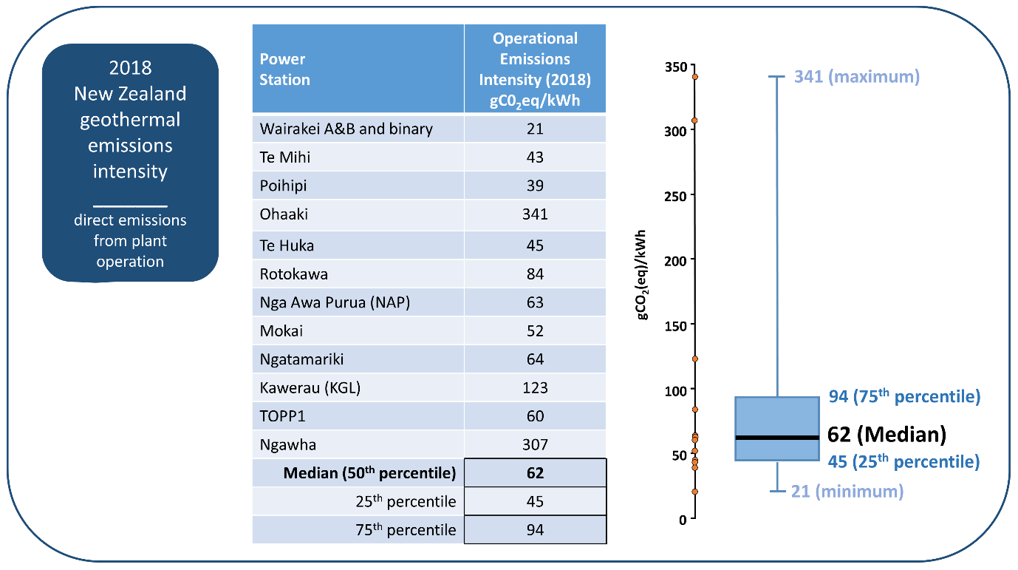
What about New Zealand?
From: https://nzgeothermal.org.nz/geothermal-energy/emissions/

Slide 8
Key Considerations
What is the natural state of the system?
How will it change after development?
Rotorua: at least 1000 tCO₂/day
Rotokawa: 441 tCO₂/day
Crater floor of White Island volcano: 124 tCO₂/day
Reference: McLean and Richardson, NZ Geothermal Workshop, 2019

Slide 9
Key Considerations
Values quoted are operational. What about lifecycle emissions (including construction and decommissioning)?
Are there also methane emissions?
Emissions may decline in time due to degassing.
Reference: McLean and Richardson, NZ Geothermal Workshop, 2019

Slide 10
New Zealand Emission Reduction
Reference: NZ Ministry of Business, Innovation and Enterprise

Slide 11
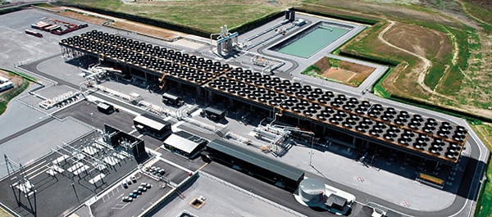
Binary Plants and CO₂
Binary plants operate in a closed loop with no atmospheric emissions (if the wells are pumped, as opposed to artesian). However Layman (2017) notes that:
- high gas contents can depress the flash point in wells down to depths below the technical limit of downhole pumps
- reservoir temperatures may exceed the 190ºC temperature limitation of the pumps.
Image: https://cdn.powermag.com/wp-content/uploads/2015/03/PWR_030115_NZGeo_Fig4.jpg

Slide 12
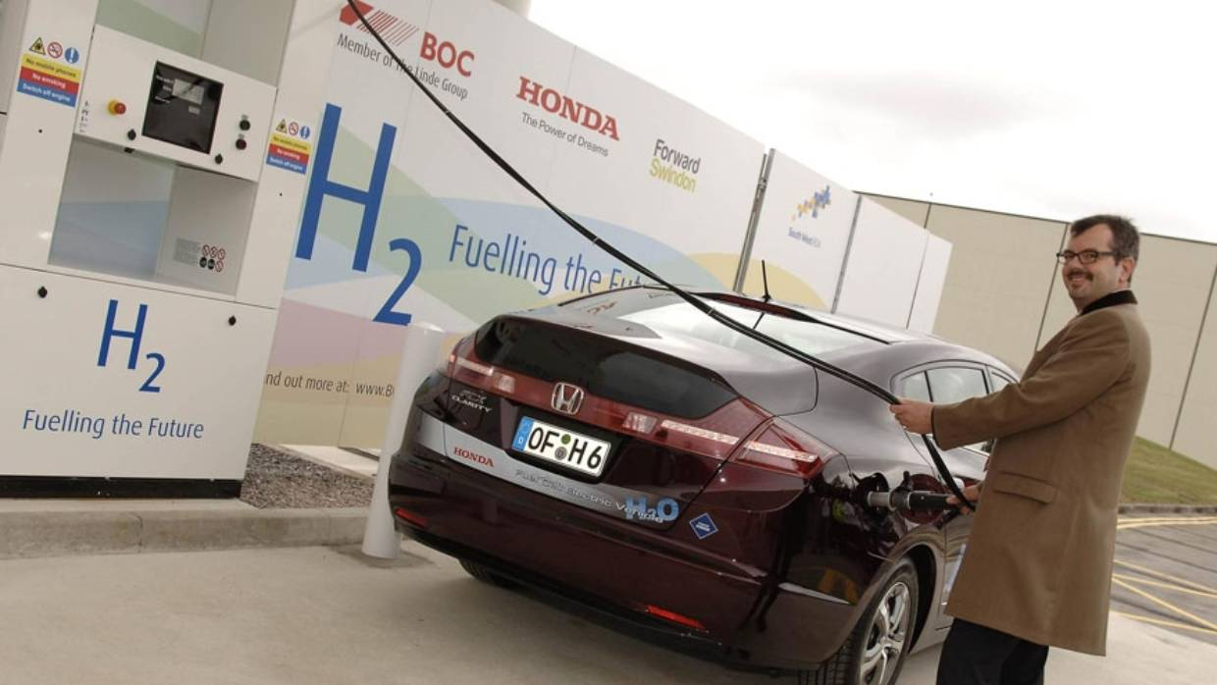
Geothermal – A Route to Displace Liquid Fuels?
Geothermal energy will be used in a pilot plant in New Zealand (at Mokai) to produce hydrogen, which can be used as a transport fuel.
NZ also incentivising electric vehicles.
http://www.tuaropaki.com/our-business/hydrogen-energy/
https://www.stuff.co.nz/business/101292443/joint-iwi-and-japan-hydrogen-pilot-project-for-taup
Notes:
NZ embracing electric vehicles (12,000 in NZ I was number 1,200)

Slide 13
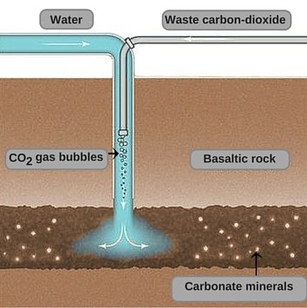
CarbFix - Iceland
Hellisheidi power plant has pumped carbon dioxide-rich gases emitted by the plant into deep underground basalt formations, mixing them with water and chemically solidifying the carbon dioxide.
Reference: Matter et al., Science, 2016
Image: https://www.scienceabc.com/innovation/
carbon-dioxide-capture-storage-underground-turned-stone-climate-change-global-warming.html
Notes:
Atmospheric CO₂ can be sequestered by injecting it into basaltic rocks, providing a potentially valuable way to undo some of the damage done by fossil fuel burning. Matter et al. injected CO₂ into wells in Iceland that pass through basaltic lavas and hyaloclastites at depths between 400 and 800 m. Most of the injected CO₂ was mineralized in less than 2 years. Carbonate minerals are stable, so this approach should avoid the risk of carbon leakage

Slide 14
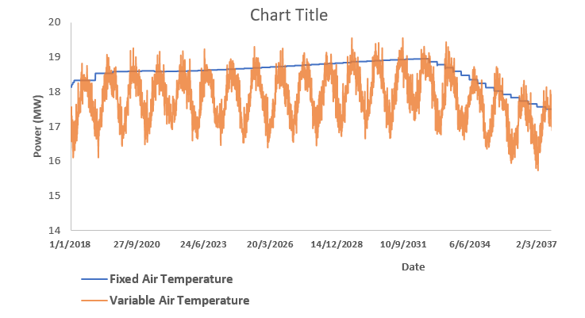
Coupled Surface/Reservoir Modelling
Image: Mohammed Dabbour, University of Auckland

Slide 15
Concluding Remarks
Geothermal systems (in their natural state) and power plants have a variable CO₂ emissions profile.
Geothermal in NZ played an important role in decarbonising electricity sector.
CO₂ from geothermal power generation may be mitigated by appropriate plant technology, reinjection, displacement of liquid transport fuels etc.

Slide 16
Prof. Rosalind Archer
r.archer@auckland.ac.nz
@Geothermal_Inst (Twitter)
Rosalind Archer (LinkedIn)

