Slide 1
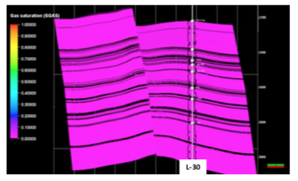
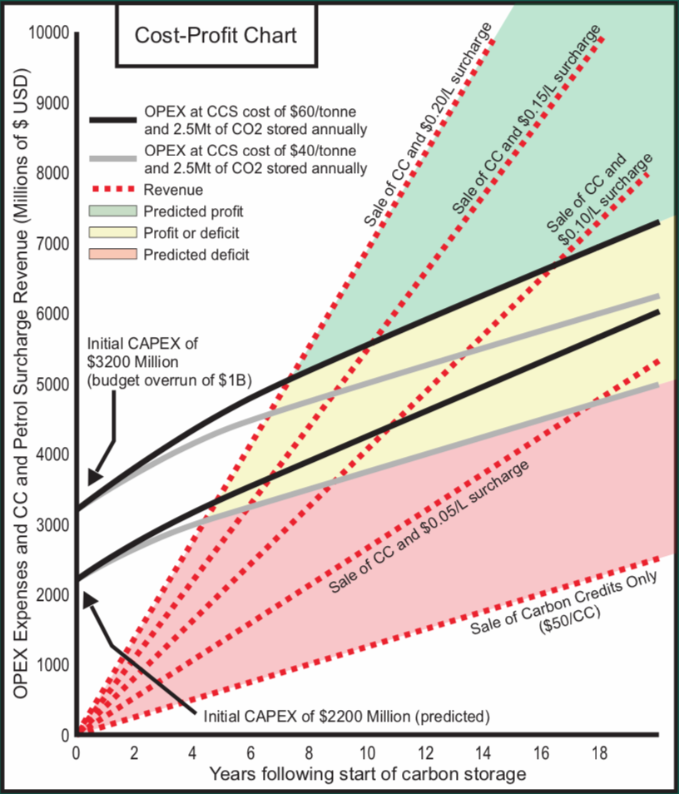
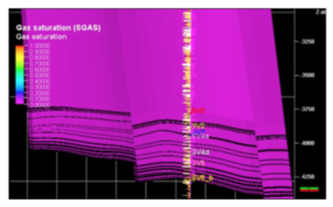
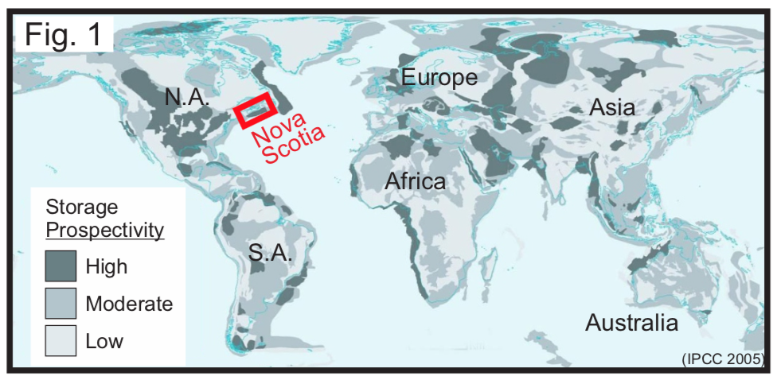
CCS Potential Offshore Nova Scotia – Dynamic Modeling and Economic Scoping Analysis Max Angel & Darragh O’Connor
← Dynamic Modeling
HC Distribution Model
“leaky” system
High integrity trap system
CCS Saline Aquifer Model
Simulations run for 7000 years
Economic Scoping Analysis →
Suggested pilot project with 2 wells injecting 1.25Mt/yr
Amalgamated cost data from 10+ CCS projects/studies
→
Year 2020 Year 9120
→

