Slide 1

February 16th, 2021
Organo-bentonite Coated Interface:
Interfacial Properties and Its Response under Cyclic Loading
Marcelo D. Benitez
Qi Liu
J. Carlos Santamarina
Energy GeoEngineering Laboratory

Slide 2
Graphical Abstract
Target Journals
Journal of Colloid and Interface Science → IF 7.5
Scientific Reports→ IF 4.0
Journal of Geophysical Research - Solid Earth→ IF 3.6

Slide 3
Table of Contents
Introduction
Material and Methods
  Materials: decane (purified) – Bentonite – CTAB
  Organo-bentonite: preparation and characterization
  Protocol: Interfacial tension
Experimental Results
  Interfacial tension as a function of time: diffusive migration to interface
  Droplet contraction and expansion: topology and interfacial tension
  Cyclic contraction-expansion
Analyses and Discussion
  Particle-interface and particle-particle interactions
  Effect of organo-bentonite on interfacial tension
  Membrane-like to shell-like interface - transition
  Mechanical properties of the shell-like interface
  Surface coverage evolution during contraction-expansion cycles
Conclusions

Slide 4

Organo - bentonite
d=19.5 Å
$2d=λ/\sin{θ}$
Raw bentonite
d=14.01 Å
y las 3 bentonitas?
Figure 1. X-ray diffraction - XRD for four different organo-bentonites and raw bentonites. All the samples were in dry condition.

Slide 5

5
OrganoBentonite
Injection - Withdraw
Syringe
Digital camera
Syringe Pump
Decane
Computer
Figure 2. Optical tensiometer and injection control. The syringe pump is computer controlled.

Slide 6





Water-Decane reference curve
No CTAB – 0.25 g/L Bentonite
${1×10}^{−5 }$M CTAB
${1×10}^{−4 }$M CTAB
${4×10}^{−4 }$M CTAB
${6×10}^{−4 }$M CTAB
${6×10}^{−4}$ M CTAB in DI water – No Bentonite
Figure 3. Interfacial tension as a function of time - Droplets in a decane bath. Droplets of: water (deionized and with surfactant C_{CTAB} = 6x10⁻⁴ M), bentonite slurries with and without CTAB (C_{bentonite} = 0.25 g/L).
Notes:
f

Slide 7


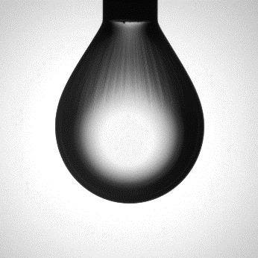
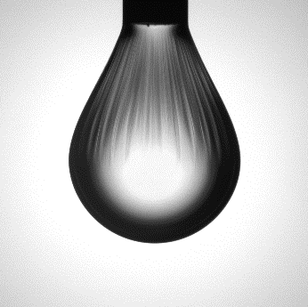
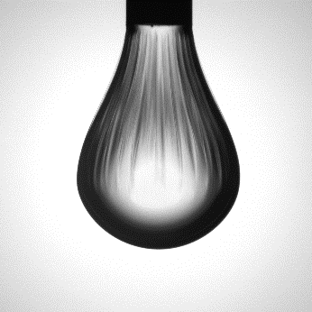
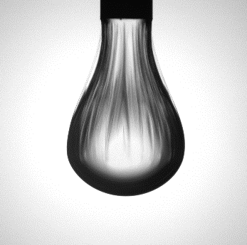
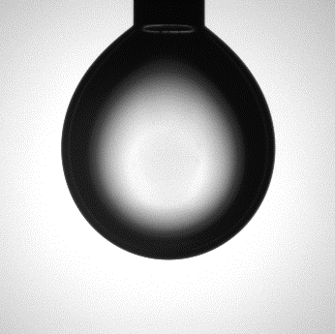
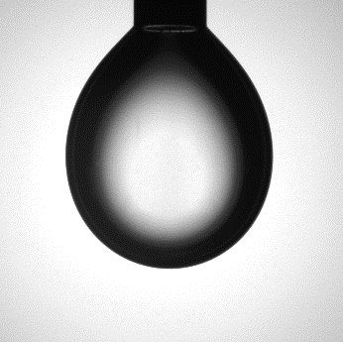
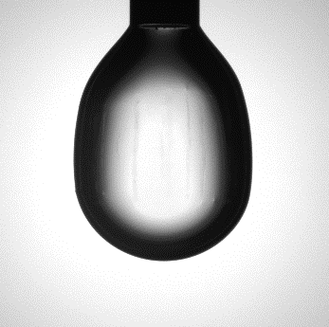


7
Contraction
1
2
3
4
5
6
11.2 μl
10.2 μl
9.2 μl
8.2 μl
7.3 μl
6.4 μl
Expansion
12
11
10
9
8
7
11.6 μl
10.6 μl
9.6 μl
8.3 μl
7.7 μl
6.4 μl
Figure 4. A contraction and expansion cycle for a droplet of organo-bentonite water suspension (C_{bentonite} = 0.25 g/L, C_{CTAB} = 1x10⁻⁴ M) in a decane bath.

Slide 8
C₀
C_{d} = 0.907
Figure 6. Droplet contraction and expansion cycles. Organo-bentonite water suspension (C_{bentonite} = 0.25 g/L, C_{CTAB} = 1x10⁻⁴ M) in decane bath. Note: Suspension withdrawal and droplet contraction stop as soon as the shell-like interface is detected.
Notes:
We assume dense triangular packing

Slide 9
Supplementary. Cycling droplet contraction and expansion. Organo- bentonite suspension (C_{bentonite} = 0.25 g/L, C_{CTAB} = 1x10⁻⁴ M). Note: Droplet expansion begins as soon as the shell-like interface is detected in the droplet.
Notes:
We assume dense triangular packing

Slide 10
Figure 7. Scanning Electro Microscopy SEM images. (a) Dry organo-bentonite suspension after evaporation (C_{bentonite} = 0.25 g/L, C_{CTAB} = 1x10⁻⁴ M). (b) Dry organo-bentonite suspension after experiencing eleven contraction and expansion cycles.

Slide 11
11
(a)
Na⁺ ion
Water
θ
θ
(c)
Oil
a
CTAB
(d)
(b)
Interface
H
CTAB
(e)
Particles
Arrangement
Figure 8. Organo-bentonite particles at the interface. (a) One nano-particle at the water oil interface. (b) Hexagonal packing of nano-particles at the interface. (c) Dry bentonite particle with Na-cations. (d) Hydrophobic bentonite particle coated with CTAB. (e) Hydrophilic bentonite particle coated with high amount of CTAB.
Notes:
CTAB → 2 nm

Slide 12
Supplementary . Sequence of images used to determine the average meridional tension of organo- bentonite suspension (C_{bentonite} = 0.25 g/L, C_{CTAB} = 1x10⁻⁴ M).

Slide 13


13
Hookean Elasticity
Young-Laplace Regime
Injection
Withdraw
$$τ_{s}$$
$$τ_{φ}$$
Figure 5. Interfacial tension evolution during the first contraction-expansion cycle. A shell-like interface forms at the last withdrawal blue point. The Young-Laplace analysis applies before particle jamming; Hookean Elasticity applies after shell formation.
Notes:
Get the good picture

Slide 14
14
(a) Contraction
Initial packing (1)
Volume contraction (3)
Shell formation (5)
*
(b) Expansion
Shell formation (7)
Volume expansion (9)
New particles (12)
Figure 10. Particles at the interface during droplet contraction and expansion – Numbers in parenthesis refer to images in Figure 4. (a) Evolution during contraction: the initial packing of particles after the adsorption time is shown in addition the reduction of droplet volume and the moment when the wrinkles form. (b) Evolution during expansion: wrinkles are fully developed. The droplet is elongated. The droplet shape changes when fluid injection and droplet expansion creates new space for additional particle adsorbtion.

Slide 15
Conclusions
We used the cationic surfactant CTAB to convert bentonite -a readily available mineral nano-particle- from hydrophilic to hydrophobic. The Brownian motion of organo-bentonites in water eventually brings these nanoparticles to interfaces where they accumulate to alter interfacial properties. Our results show:
The accumulation of organo-bentonite particles at the interface is time dependent.
The adsorption of organo-bentonite particles at the oil-water interface can dramatically reduce the apparent interfacial tension during droplet contraction.
A shell-like interface eventually develops after particle jamming during droplet contraction, and it can resist compressive stress.
Further contraction leads to the formation of wrinkles and shell buckling.
The shell-like interface is subjected to an anisotropic stress field and cannot be described by the Young-Laplace equation.
The evolution of interfacial tension during contraction and expansion shows a strong hysteresis effect.
The number of particles adsorbed at the interface and the droplet size at shell formation gradually increase with the number of contraction-expansion cycles.

